Slide 1
3d Εκτύπωση και Τεχνικές Σχεδιασμού
Αγγελόπουλος Παναγιώτης
1^{ο} Γυμνάσσιο Βριλησσίων

Slide 2
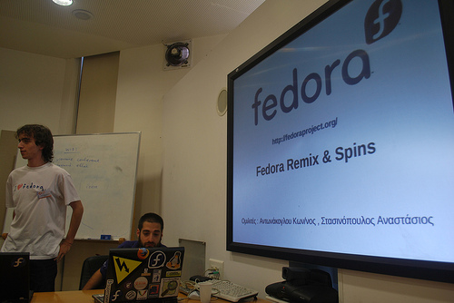
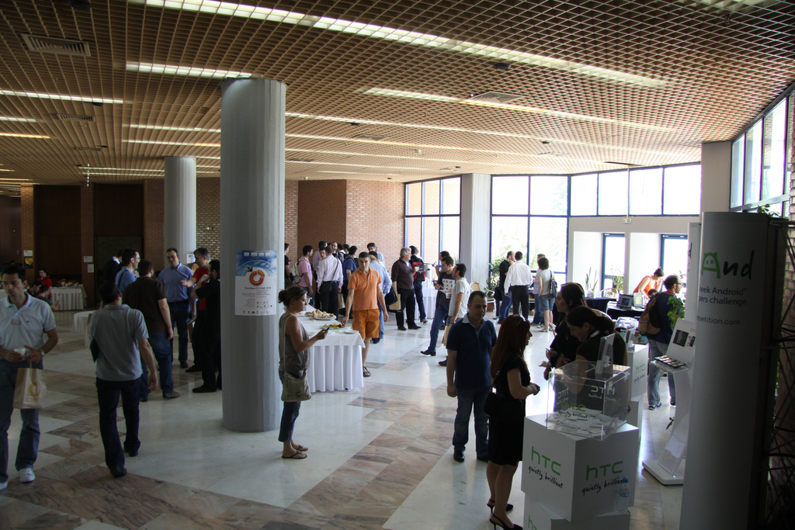
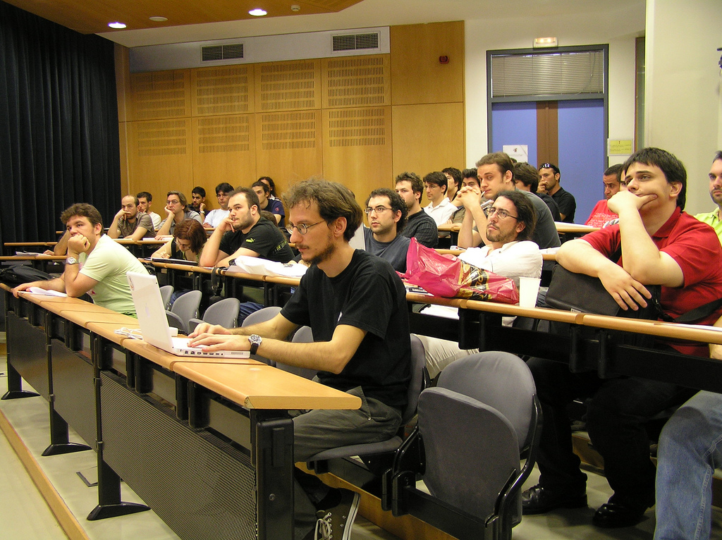
ΕΕΛΛΑΚ-GFOSS
www.ELLak.gr-www.gfoss.eu
Established in 2008, in operation since 1996
members: 36 Hellenic Universities and Research Centers
non-profit organization with shareholders its members
Objective
Promote Open Technologies in collaboration with MoE, Universities, Schools, municipalities, tech communities and Civil Society
Leading Organization in promoting Open STEM initiatives in the Hellenic Education

Slide 3
Open Technologies in Schools RELATED TO STEM projects)
Project | Description
Co[de] & Create (https://gfoss.eu/code-create/) | Two open labs with open educational material in English (available at elearn.ellak.gr at GFOSS moodle platform) to provide free STEM courses to mixed classes of refugees and Greek youth (coding, 3d design & printing, robotics etc)
Hack Your Classroom | Workshops to schools with 3d printers, arduino, RaspBerry Pi
Open Schools Programme | Workshops and OER in 3d Printing, OER, OpenStreetMap. Wikipedia, Linux
Robotics with Open Technologes in Schools & Communities | -Open Hardware Robotics School Competition (robotics.ellak.gr) -Aegean Robotics Competition
Conferences on Open Technologies and OER | FOSSCOMM, OPENFEST, OSS 2018 MOODLEMOOT, National Scientix Conference
3D printers in schools | 3d printers in schools
Edulabs | Maker spaces in schools including 3d printers and Scanners, arduino, RaspBerry Pi, Open Software etc
Scientix | National Contact Point

Slide 4
Τρισδιάστατα εργαλεία μοντελοποίησης και σχεδίασης
Name | Level | OS | Price | Format
TinkerCAD | Beginner | Browser | Free | 123dx, 3ds, c4d, mb, obj, svg, stl
LibreCAD | Beginner | Windows, macOS and Linux | Free | dxf, dwg
3D Slash | Beginner | Windows, Mac, Linux, Raspberry Pi or Browser | Free | 3dslash, obj, stl
SculptGL | Beginner | Browser | Free | obj, ply, sgl, stl
FreeCAD | Intermediate | Windows, Mac and Linux | OPEN SOURCE | step, iges, obj, stl, dxf, svg, dae, ifc, off, nastran, Fcstd
OpenSCAD | Intermediate | Windows, Mac and Linux | Free | dxf, off, stl
MakeHuman | Intermediate | Windows, Mac, Linux | Free | dae, fbx, obj, STL
Meshmixer | Intermediate | Windows, Mac and Linux | Free | amf, mix, obj, off, stl
Blender | Professional | Windows, Mac and Linux | OPEN SOURCE | 3ds, dae, fbx, dxf, obj, x, lwo, svg, ply, stl, vrml, vrml97, x3d

Slide 5
TINKERCAD
https://www.tinkercad.com/
online 3D design and 3D printing app

Slide 6
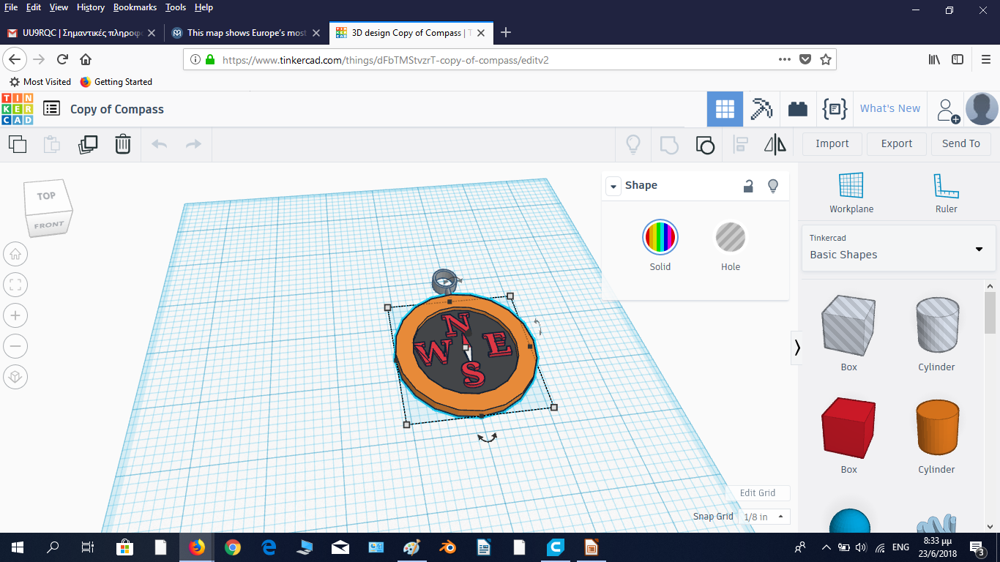
Περιβάλλον σχεδιασμού και ανάπτυξης
TINKERCAD

Slide 7
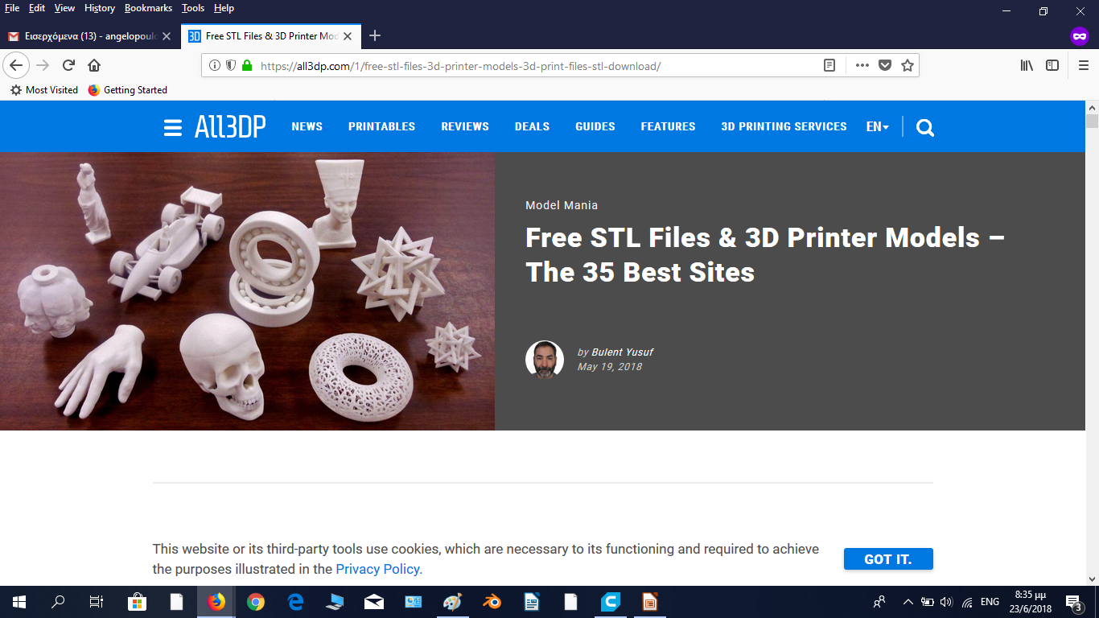
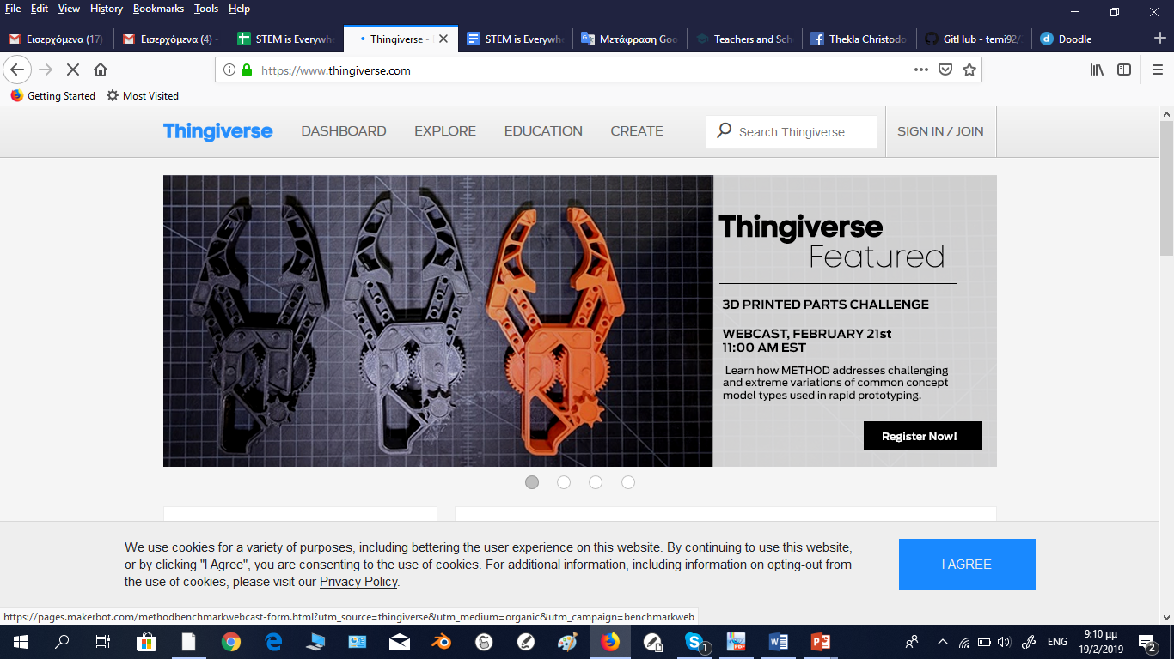
STL Αρχεία
https://all3dp.com/1/free-stl-files-3d-printer-models-3d-print-files-stl-download/
https://www.thingiverse.com/

Slide 8
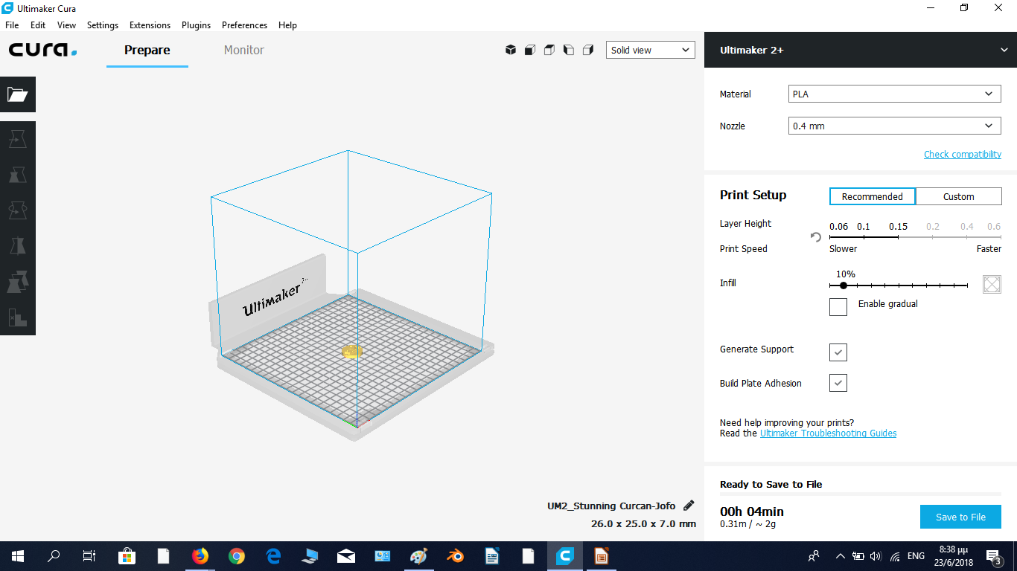
CURA
A 3D Printing Software

Slide 9
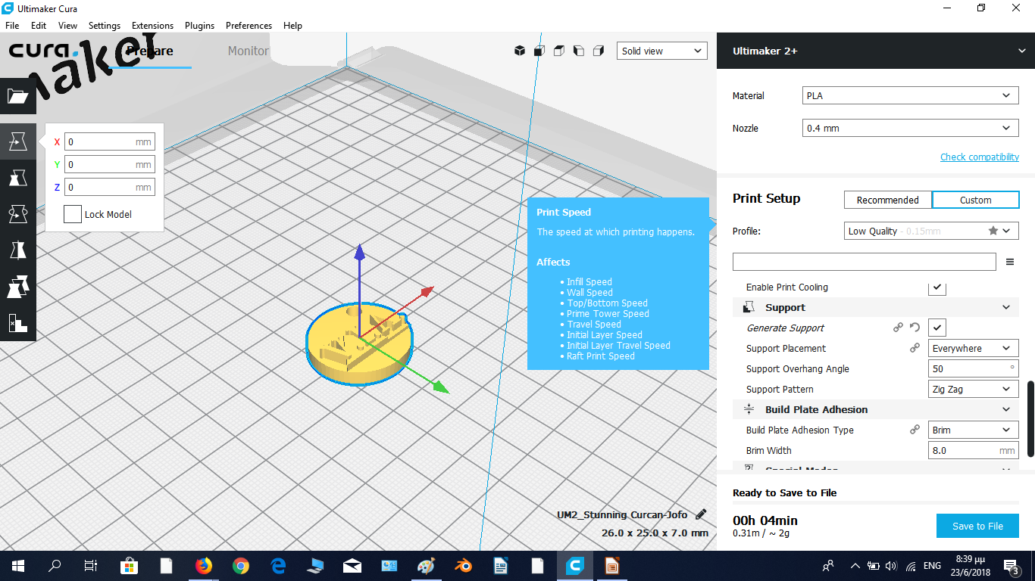
CURA

Slide 10
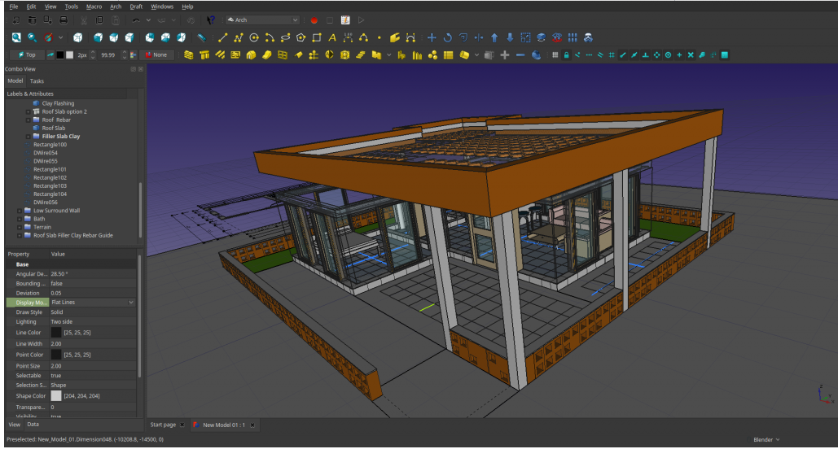
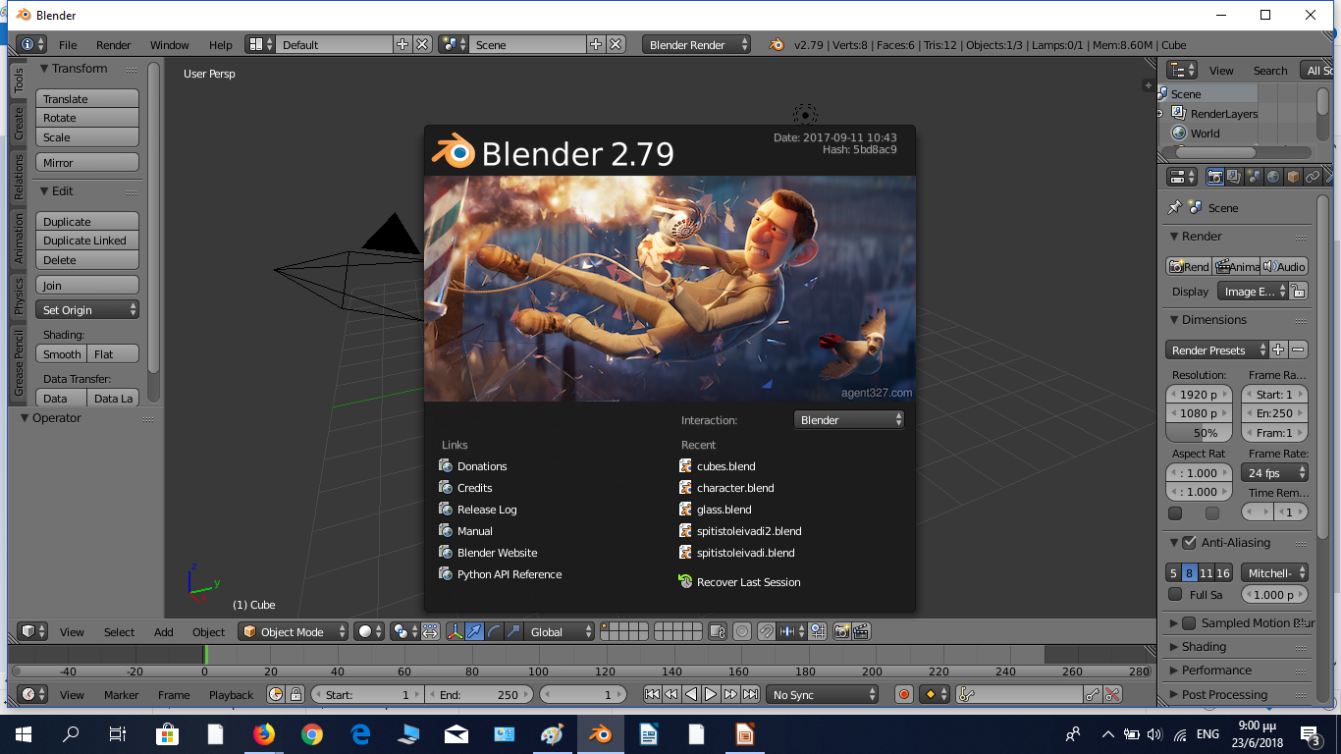
Open Source 3D Modelling and Design Software
FreeCAD
https://www.freecadweb.org/
FreeCAD Tutorials
https://www.youtube.com/watch?v=TLf2KVrtGew
Blender
https://www.blender.org/
Blender Tutorials
https://www.youtube.com/watch?v=LLV7h-WLIx0&t=5s

Slide 11
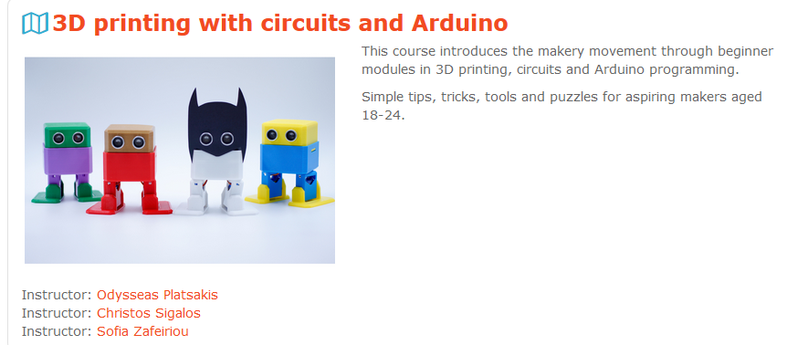
Robotics and 3D Printing
https://elearn.ellak.gr/enrol/index.php?id=63

Slide 12
Σεμινάρια ΕΕΛΛΑΚ στη Κύπρο και παρουσιάσεις : https://drive.google.com/drive/folders/17ZQJzg8sJe13sIkpaDpQq2fWcxA56Fb1
Code and Create μαθήματα:
https://elearn.ellak.gr/course/view.php?id=52
2) https://elearn.ellak.gr/course/view.php?id=59
Άρθρα www.edu.ellak.gr για 3d printing https://edu.ellak.gr/category/3d-printing-stin-ekpedefsi/

Slide 13
3d Scanning
https://all3dp.com/2/5-best-3d-scanner-apps-for-your-smartphone/
https://www.aniwaa.com/best-3d-scanning-apps-smartphones/
3D SCANNING Kinect for XBOX one
E-mail: angelopoulos.takis@gmail.com
Ευάγγελος Κανίδης
E-mail: vkanidis@gmail.com
Site: vkanidis.gr

